Slide 1
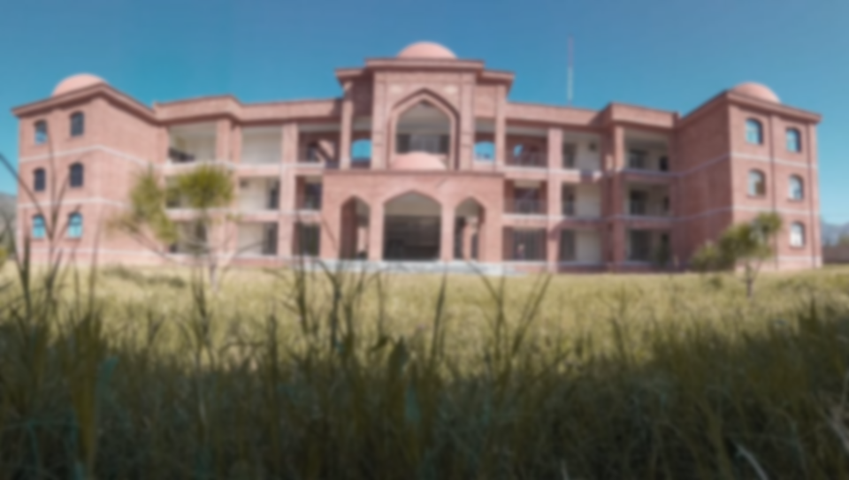
AUST MANAGEMENT SYSTEM

Slide 2
PRESENTED BY:
SOHAIL ASGHAR (9454)
SANIA ASAD (9413)
ILYAS SHAH (9431)
NADIA NOOR (9411)

Slide 3
ABOUT PROJECT:
Design project using html , CSS , php and SQL database.
In School Management Project , we design 3 different profile one is for student information , 2nd is for teacher information and last one is for admin wo will access the database.

Slide 4
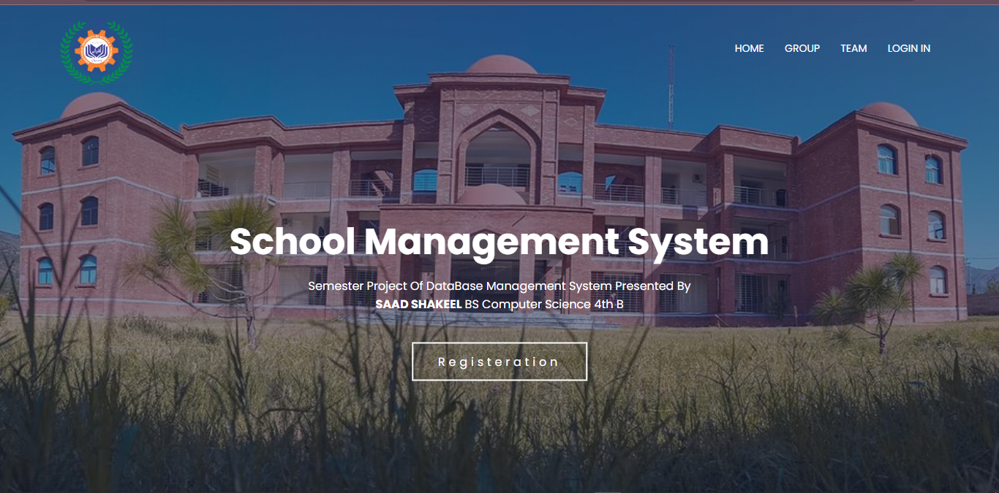
HOME PAGE:

Slide 5
HOME PAGE:
The first page index.html, we will design nav links.
Home link target the same page (index.html).
Group and Team link both target the intro page of our group members.
Login in and Registration button target the 2nd page which we will discuss below.

Slide 6
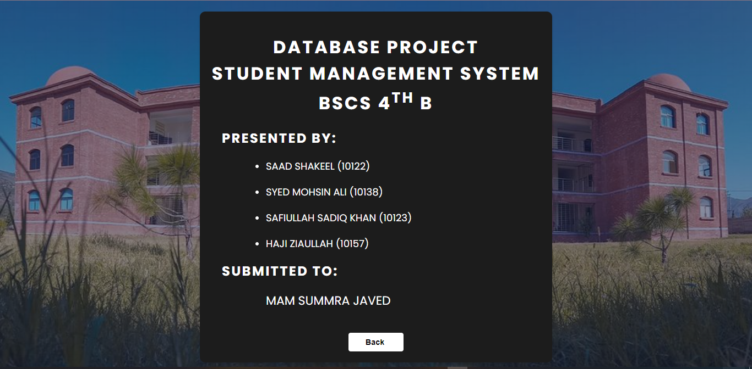
GROUP AND TEAM LINKS :

Slide 7
REGISTRATION BUTTON
The registration button target the admin page where we design 3 different profile.
One is for students registration.
2nd for teacher.
3rd for admin.

Slide 8
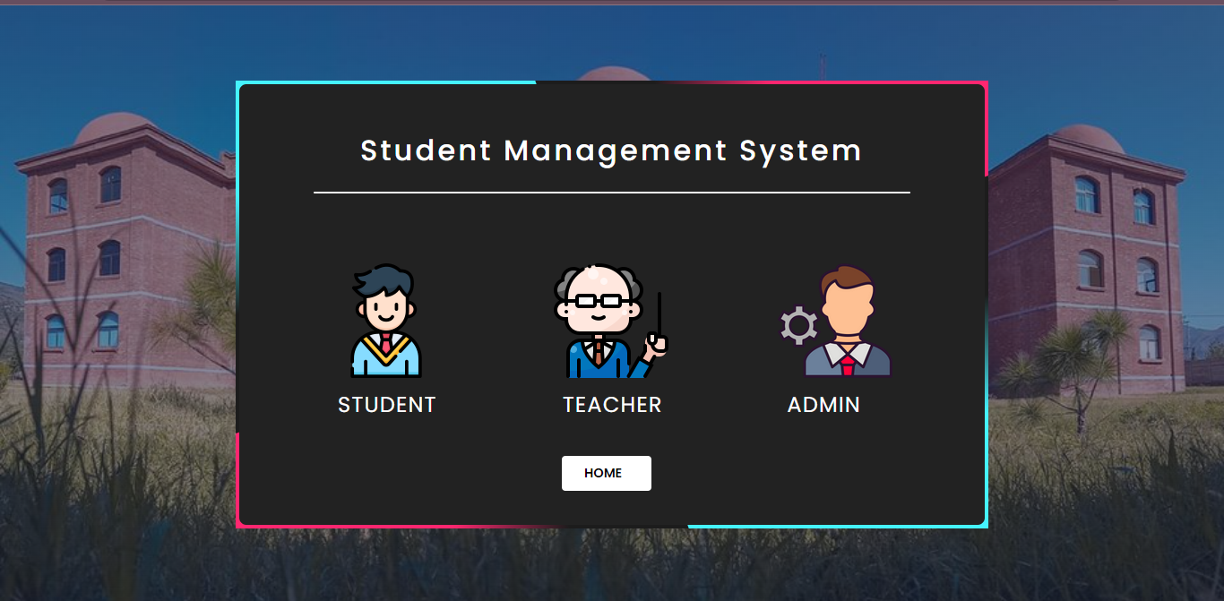
REGISTRATION BUTTON

Slide 9
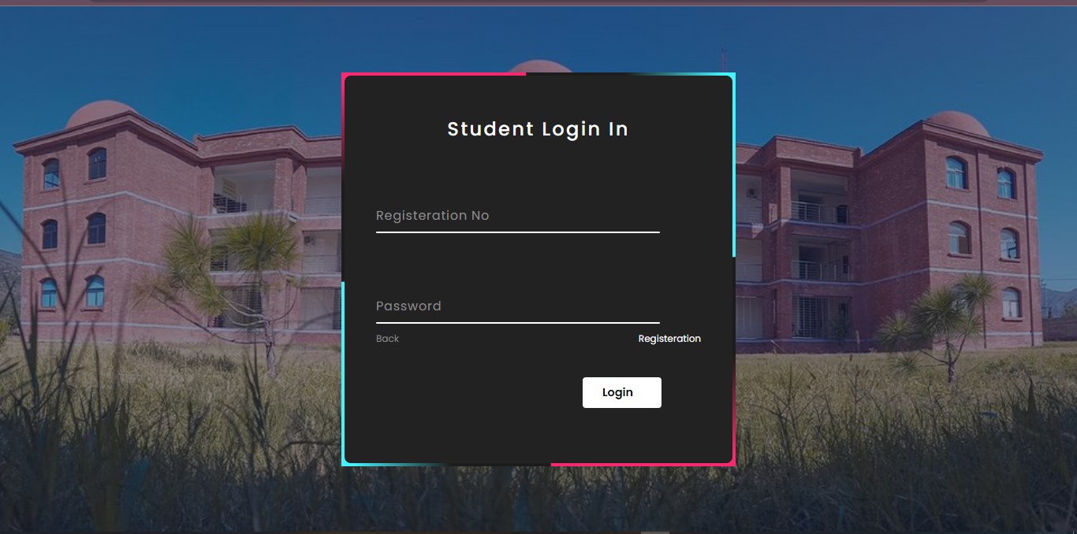
STUDENT PROFILE:
The student profile target the student login page.

Slide 10
WORKING OF STUDENT PROFILE:
In student login page, user enter registration no and password.
If user doesn’t register their student form then first complete the registration.
For registration click on right side link (registration).
This registration link target the student info form.

Slide 11
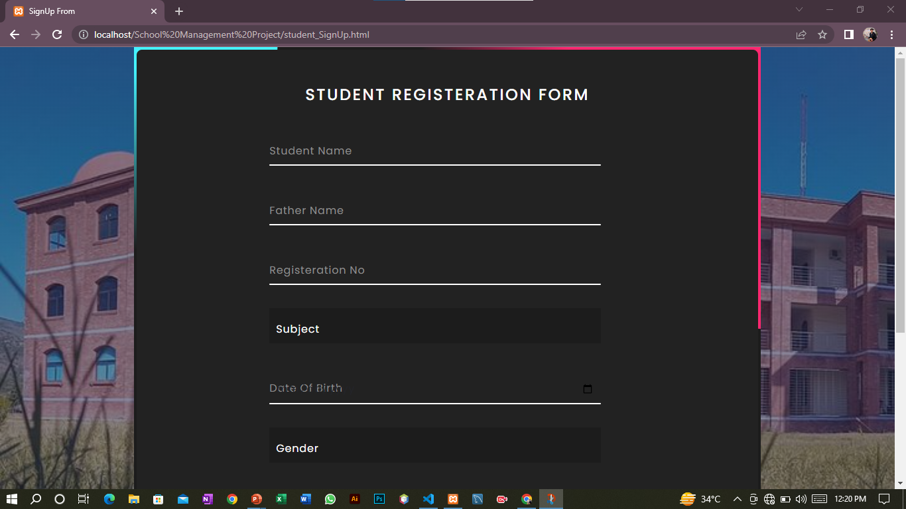
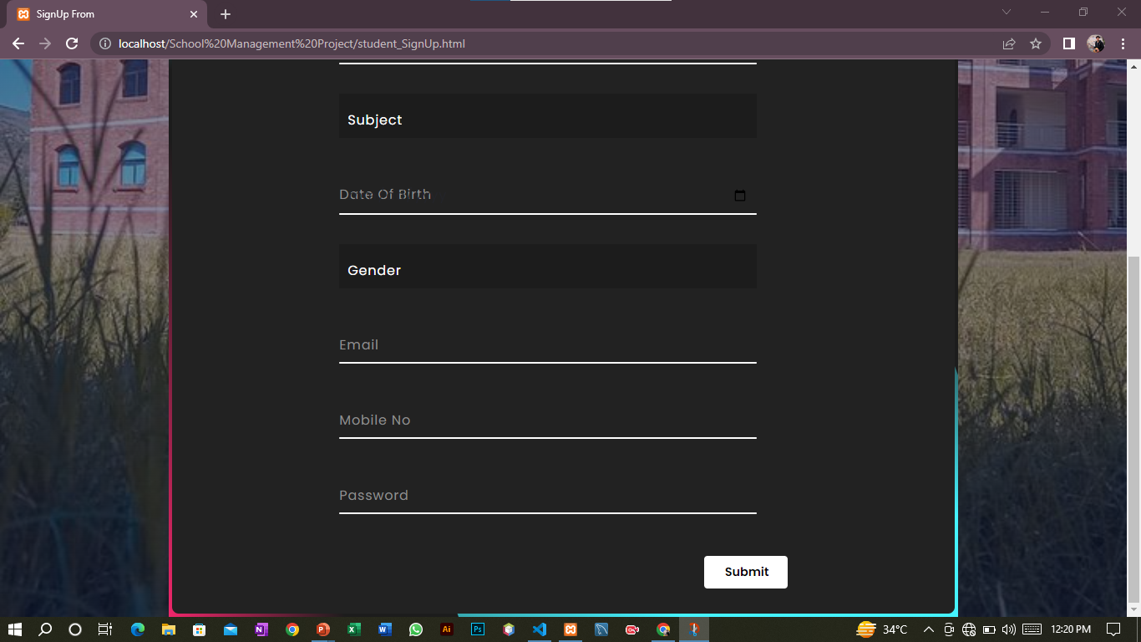
STUDENT REGISTRATION FORM:

Slide 12
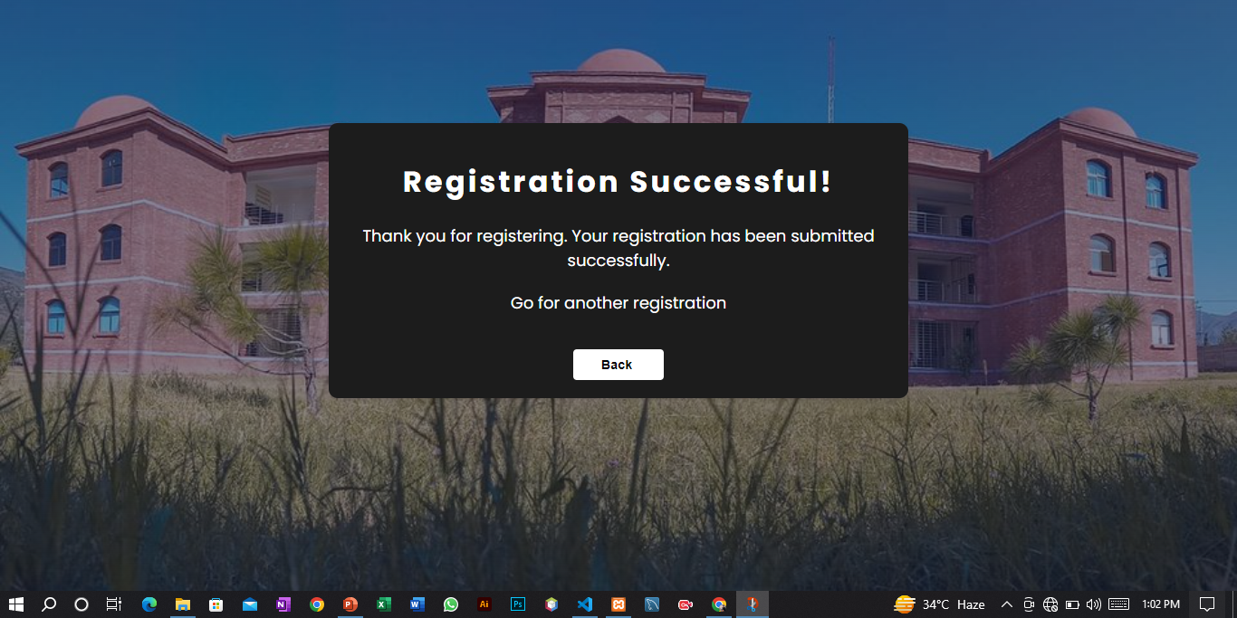
STUDENT REGISTRATION FORM:
When click submit button.
Back button target the admin page where profiles are present.

Slide 13
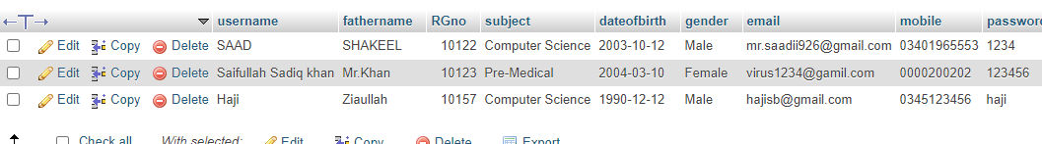
WORKING OF REG. FORM
The user input require information that are show in above form.
To click submit button all the information store in database.

Slide 14
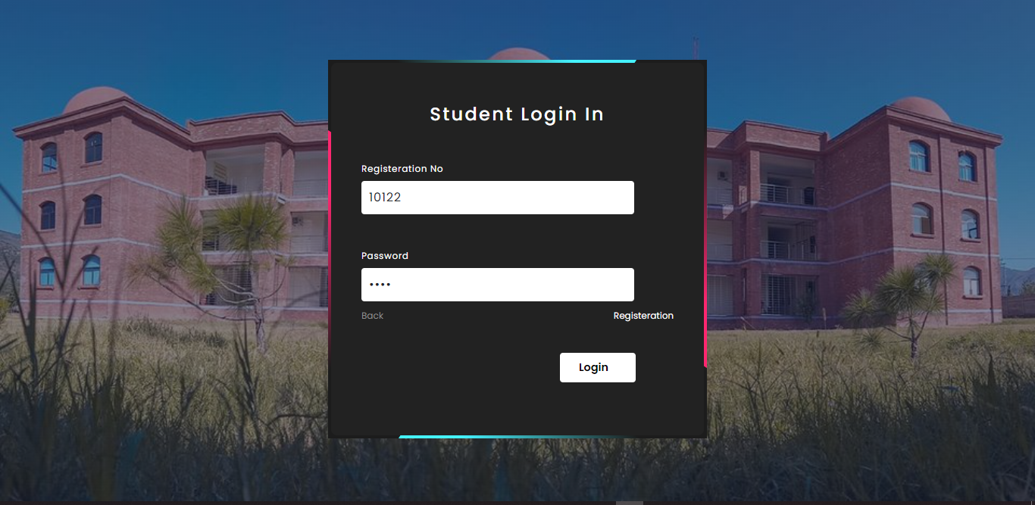
WORKING OF STUDENT PROFILE:
Now complete registration, to confirm user registration, again went to student login form and enter registration no and password.

Slide 15
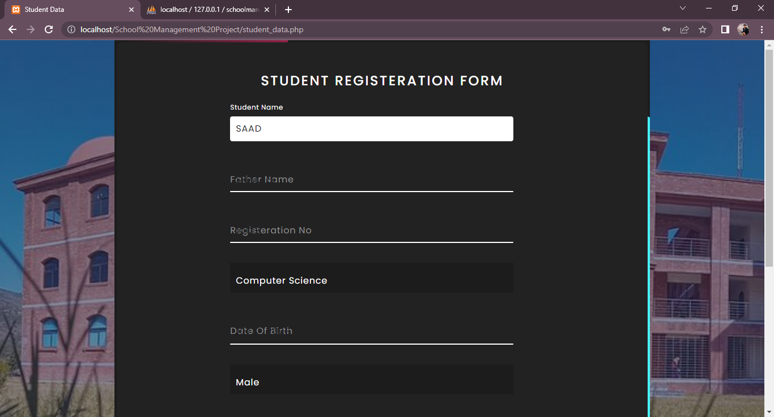
WORKING OF STUDENT PROFILE:
If registration no and password are correct then your data are show in from, but user can’t edit this data. It on readonly mode.

Slide 16
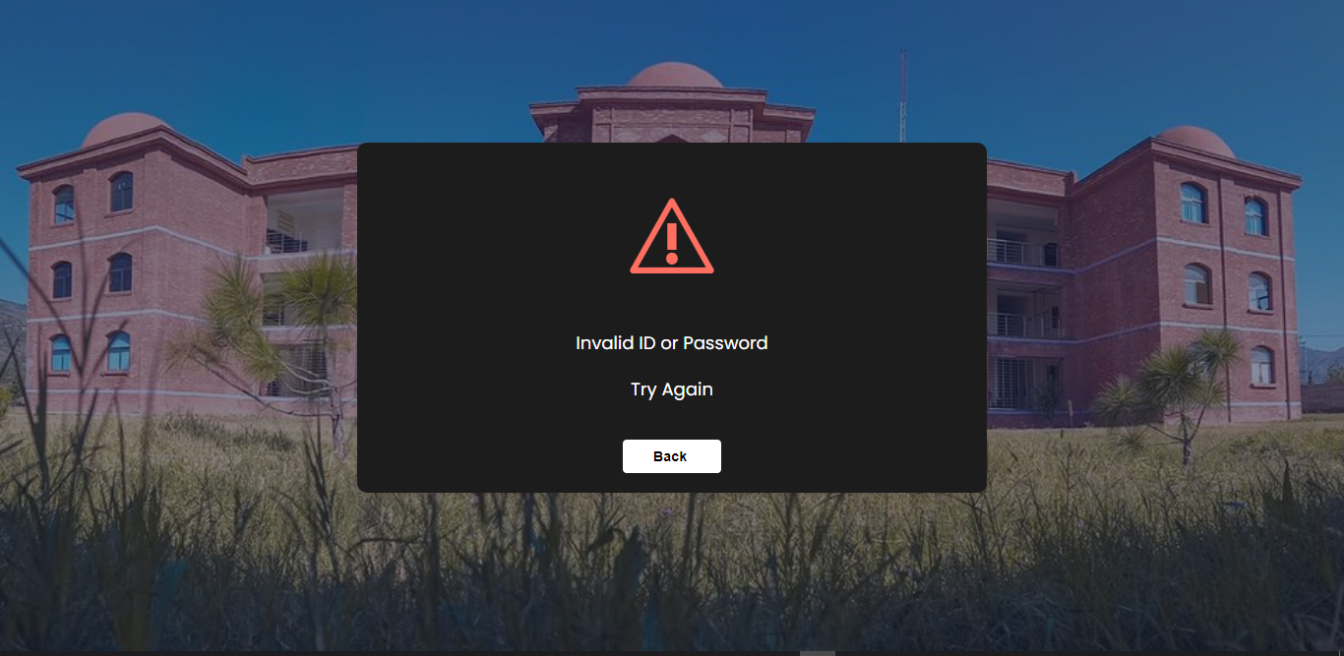
WORKING OF STUDENT PROFILE:
if registration no or password doesn’t correct then the error will display.

Slide 17
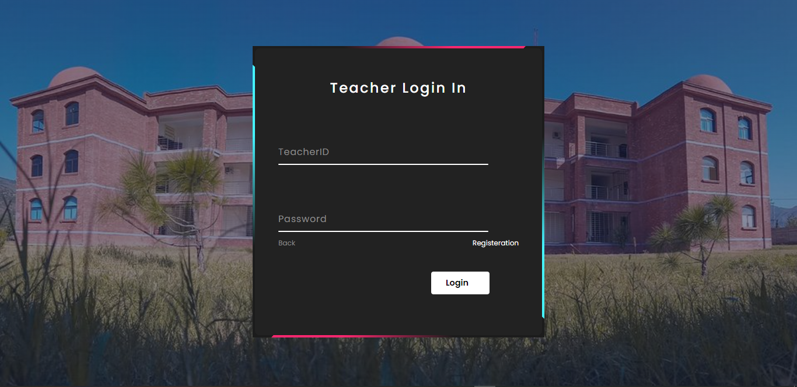
TEACHER PROFILE:
Teacher profile work same as student profile.
The login are same , input data are different.

Slide 18
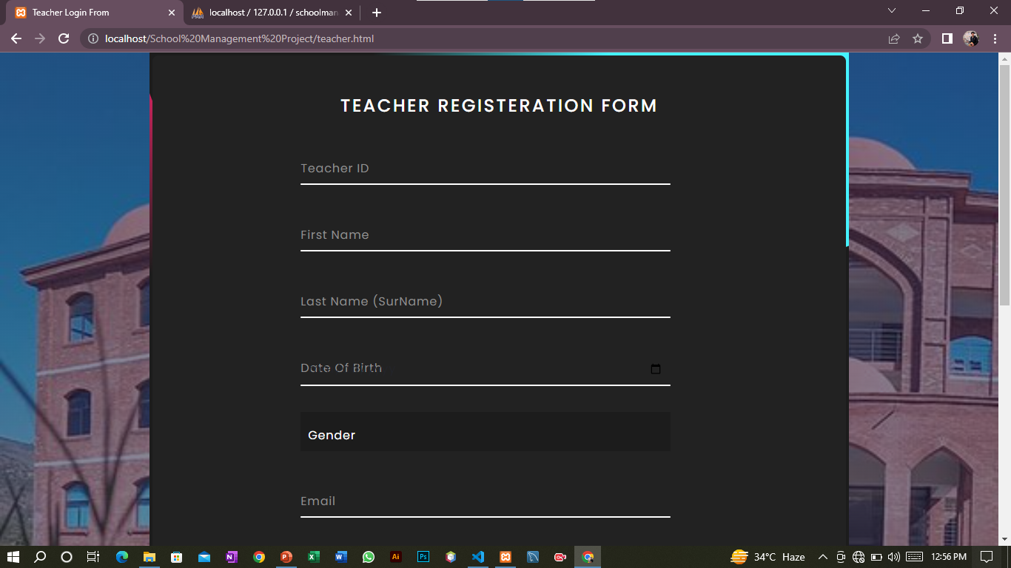
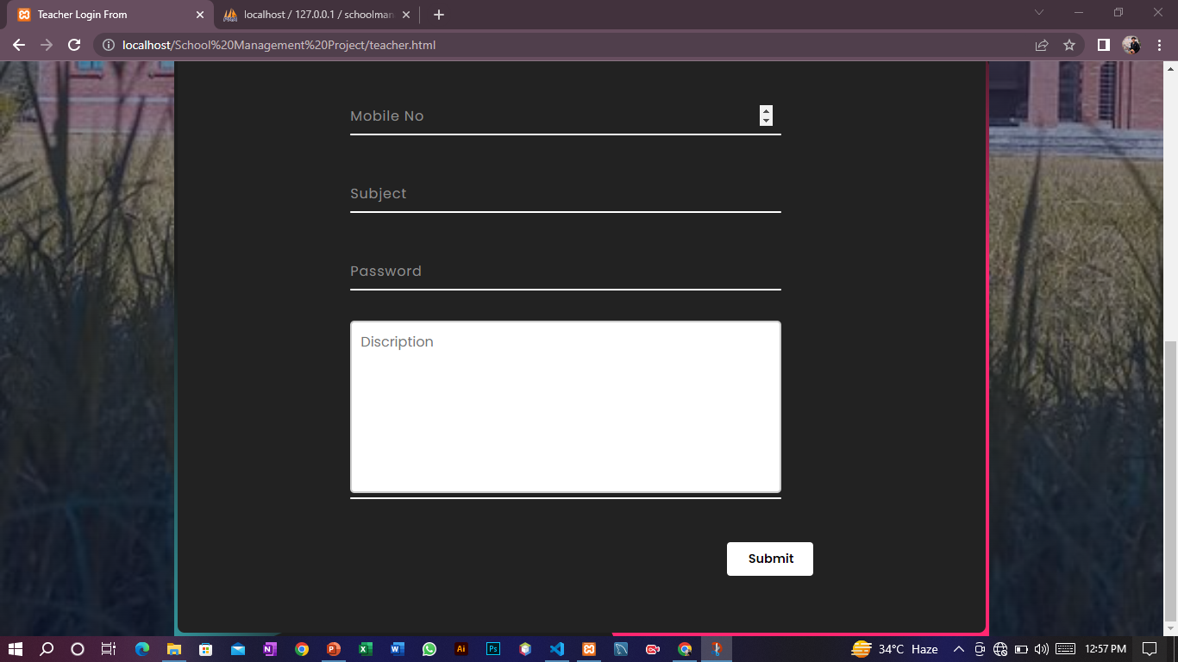
TEACHER REGISTRATION FORM:

Slide 19
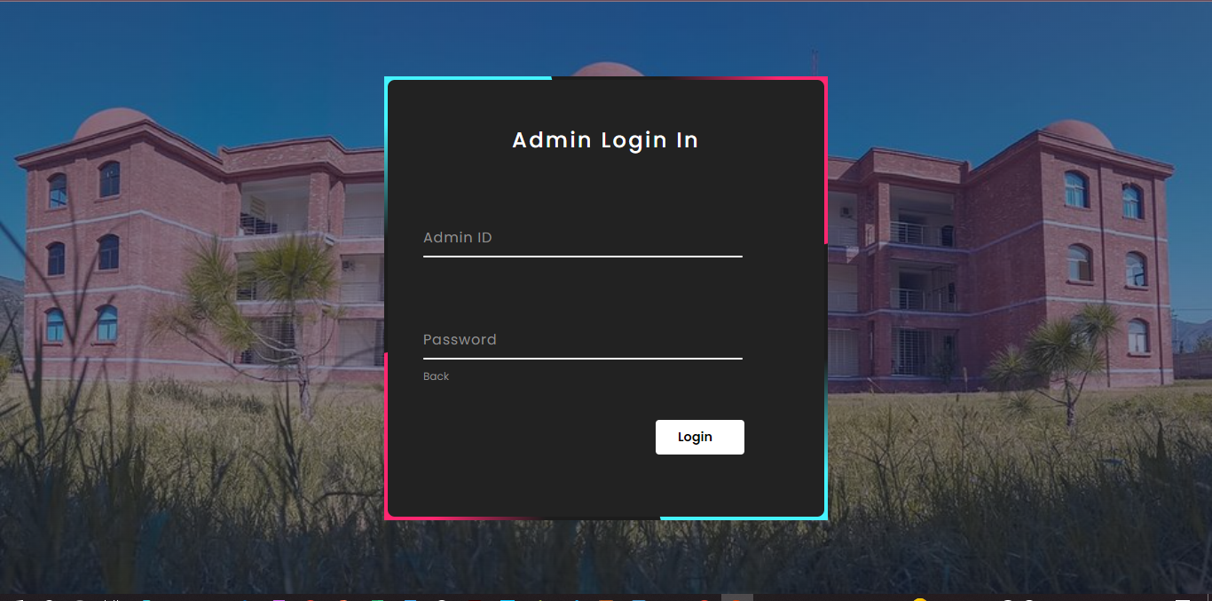
ADMIN PROFILE:

Slide 20
ADMIN PROFILE:
To login admin profile, input admin id and password.
Admin access all the data of students teacher and admins.
To click login in button, the student management database will be access.
By adding new admin, already registered admin add the profile of new admin through in phpMyAdmin.

Slide 21
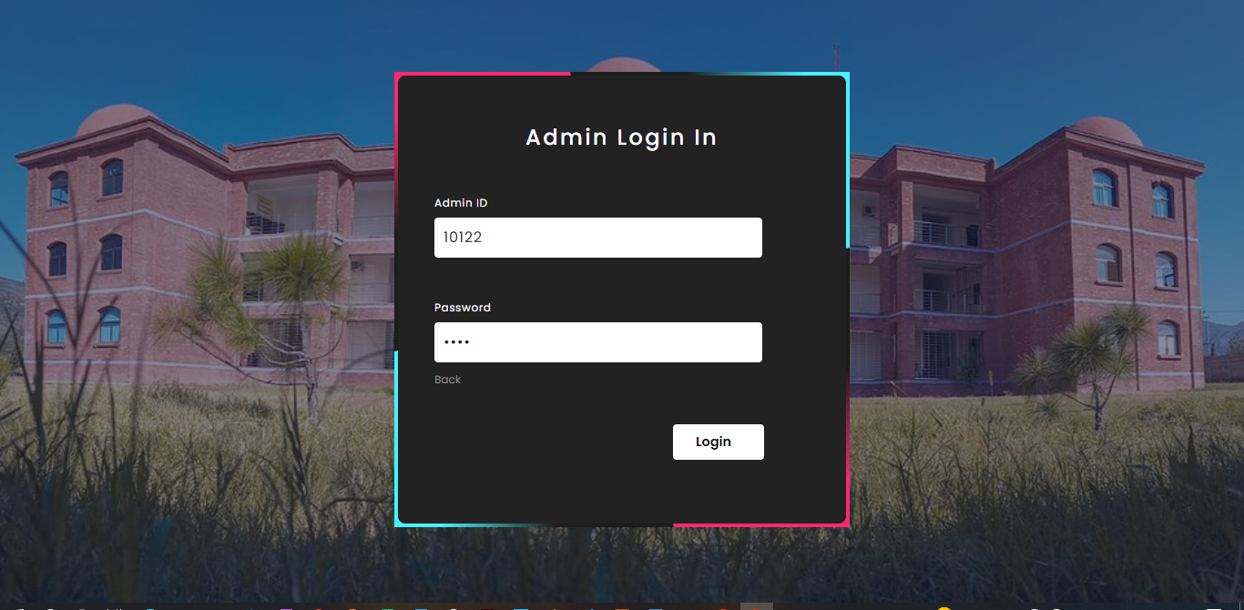
ADMIN PROFILE:
Click login button, this button target the local data base.

Slide 22
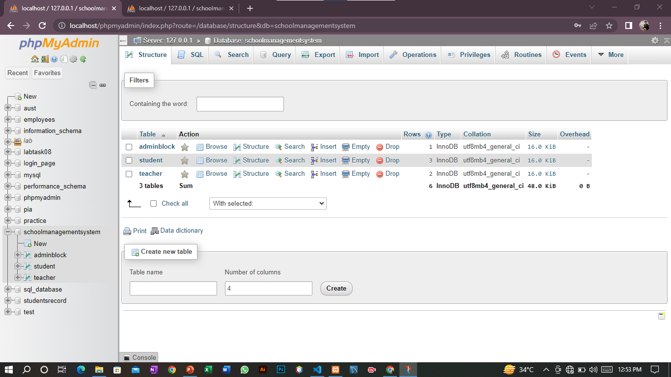
ADMIN PROFILE:

Slide 23
SUBMITTED TO:
MAM MARIA GUL
Thanks

